Slide 1



Nursing & the Future of Healthcare:
A Professional Call to Action
Susan D. Ruppert, PhD, RN, ANP-BC, NP-C, FNAP, FCCM, FAANP, FAAN
Nurse Leader – Gulf Coast Regional Leadership Team

Slide 2

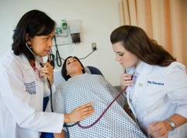



Health Care System Challenges
Fragmentation
High costs
Health care disparities
Primary care shortage
Aging and sicker population

Slide 3
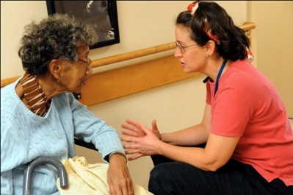


RWJF’s Commitment to Improving Care
RWJF MISSION
To improve health and health care for all Americans
Need to address challenges facing nursing to address challenges facing our health system

Slide 4
Collaboration
Prepare more nurses to help lead improvements in health care quality, safety, access and value
Integrated, collaborative,
patient-centered health care teams
Interprofessional education, training and practice

Slide 5

Institute of Medicine Report
High-quality, patient-centered health care for all will require a transformation of the health care delivery system
AJN Book of the Year Award
One of the most-viewed online reports in IOM history

Slide 6
IOM Recommendations
1) Remove scope-of-practice barriers
2) Expand opportunities for nurses to lead and diffuse collaborative improvement efforts
3) Implement nurse residency programs
4) Increase the proportion of nurses with a BSN degree to 80% by 2020
5) Double the number of nurses with a doctorates by 2020
6) Ensure that nurses engage in lifelong learning
7) Prepare and enable nurses to lead change to advance health
8) Build an infrastructure for the collection and analysis of interprofessional health care workforce data

Slide 7
IOM Recommendations
Enabling nurses to practice to the full level of their training.
Implement nurse residency programs.
Preparing and enabling nurses to lead change.
Expand opportunities for nurses to lead and diffuse collaborative improvement efforts.
Prepare and enable nurses to lead change to advance health.
Remove scope-of-practice barriers.
Improving workforce data collection and analysis.
Build an improved infrastructure to collect and analyze health care workforce data.
Ensure that nurses engage in lifelong learning.
Double the number of nurses with a doctorate by 2020.
Increase proportion of nurses with a BSN degree to 80% by 2020.
Improving nursing education.
Fostering Interprofessional Collaboration
Diversity

Slide 8

Convergence of Forces in Texas:
The Perfect Storm
Sagging economy – Texas faces billion $ deficit
Surging and unsustainable cost of health care
Escalating population growth and diversity
Aging and uninsured population
  22% of residents will be 60+ by 2030 (7,498,859)

Slide 9

Texas Healthcare
Texas Ranks:
  40th in adults with diabetes
  44th in health status (19% report fair/poor health)
  46th in overall healthcare
  46th in number of providers needed to meet needs of anticipated addition patients with coverage under PPACA
  47th in primary care physician supply ratio
  50th in percent of residents without health insurance (24.4%- compared to 16.3% nationally)
  50th in access to healthcare

Slide 10
Texas Healthcare
185 (73%) of the 254 counties in Texas are designated as medically underserved
188 of the counties are designated as having acute primary care physician shortages (16 have 1, 23 have 0)
Expansion of health coverage to 6 million more Texans will overload a system already strained, particularly in rural areas

Slide 11
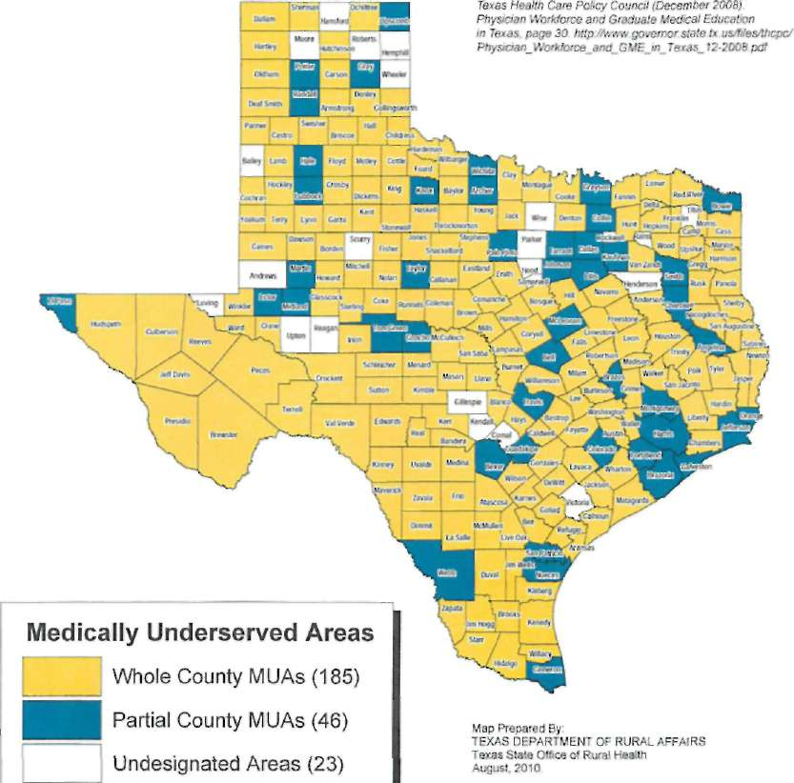
MEDICALLY UNDERSERVED AREAS
The Texas Health Care Policy Council (THCPC) in its 2008 report finds, "Greater use of non-physician practitioners, particularly physician assistants and nurse practitioners, may alleviate the potential shortage of physicians and increase access to care." Further, THCPC says, "New and different health care service delivery models such as increased use of non-physician providers, ... have the potential to improve access, increase the availability of care, and reduce costs. Current regulation of non-physician health care professionals prevents the full benefit of these alternative delivery models from being realized."
Data Source: http://www.orca.state.Jx.us/TxDRA/Libraries/sorhDocs/MUAs.sflb.ashx

Slide 13
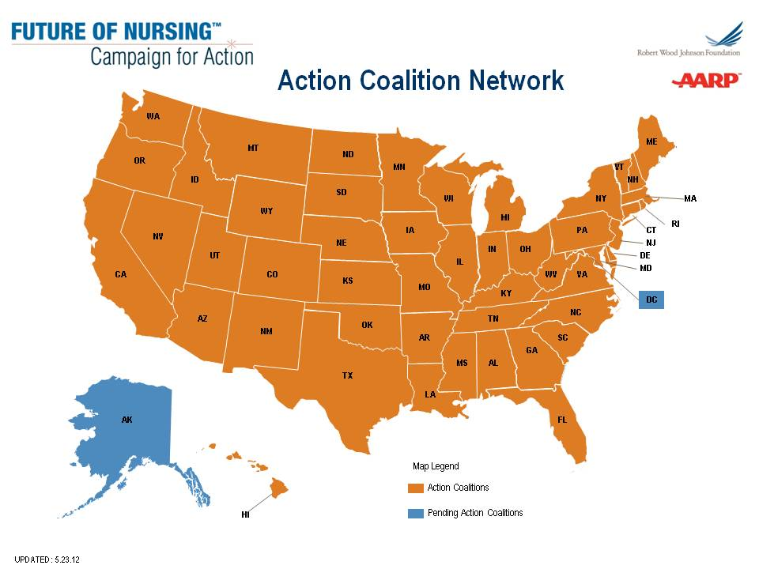
Campaign for Action
State Involvement
Notes:
We’re also mobilizing on the ground at the state level in nearly every state. And we plan to be in Oregon and Alaska by the end of this year.
Action Coalitions are long-term alliances that we’re using to move key nursing-related issues forward at the local, state and national levels. We’re capturing best practices, tracking lessons learned and identifying replicable models.

Slide 14
Our Commitment to Advance the Health of Texans through Nursing
“Better Care, Better Health, Reduced Cost”

Slide 15
The Texas Mission
Set clearly defined goals which align with IFN recommendations
Form and mobilize the broadest circle of agencies, communities, organizations, and public stakeholders representing a variety of sectors
Educating policymakers and other decision-makers
Reach out to philanthropies/funders to seek financial support for RAC efforts;
Gain visibility through the media and other outlets
Work to advance key IFN recommendations in Texas

Slide 16


Texas Team Lead Organizations
Ellarene Sanders – Interim Executive Director
Cindy Johnson – VP Clinical Services

Slide 17
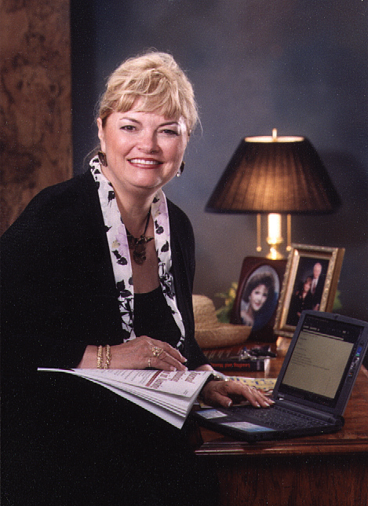
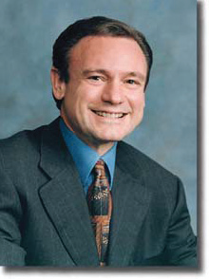

Texas Team StAC Co-Chairs
Dr. Patricia Yoder-Wise
Dr. Ray Perryman

Slide 18
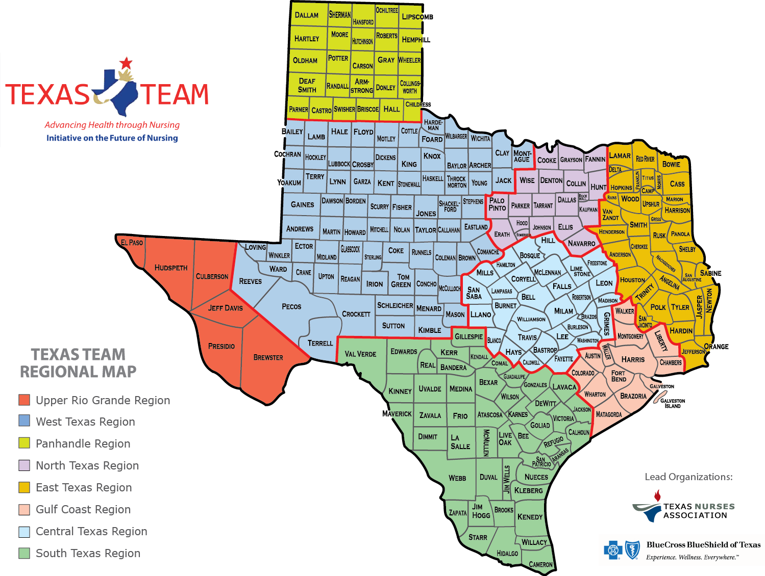
New Texas Team

Slide 19
Team 13 Counties
  Austin Liberty
  Brazoria Matagorda
  Chambers Montgomery
  Colorado Walker
  Fort Bend Waller
  Galveston Wharton
  Harris

Slide 20
Gulf Coast
Regional Leadership Team
Susan D. Ruppert, PhD, RN, ANP-BC, NP-C, FNAP, FCCM, FAANP, FAAN – Nurse Co-Leader
Denise Neill, PhD, RN, CNE – Nurse Co-Leader
Michelle B. Leben – Business Co-Leader
Veronica Abdur-Rahman, PhD, M.Ed., RN
Mary Beth Bess, MSN, RN, CFNP
Dana Bjarnason, PhD, RN, NE-BC
Susan E. Dierker, MSN, RN, NEA-BC
Pamela K. Greene, PhD, RN
Viola L. Hebert, MA, BSN, RN
Victoria King, MHA, MSN, RN, CNOR, NEA-BC
David R. Marshall, JD, DNP, RN, NEA-BA, CENP
Diane McGraw, MS, RN, CNS-CH, CPHQ, CCM
Mary E. Koch, MSSW – Consultant
Dana S. Smith, PhD, LMSW, MPA
Lynn Voskamp, MSN, RN
Nitha Mathew, MSN, RN (Jonas Scholar)
Darlene Tubera, MSN, RN, CCNS-BC (Jonas Scholar)
Ursula Rodriguez, DNP, RN, FNP-BC (Jonas Scholar)

Slide 21
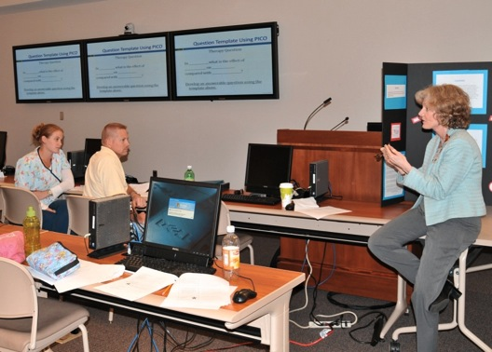
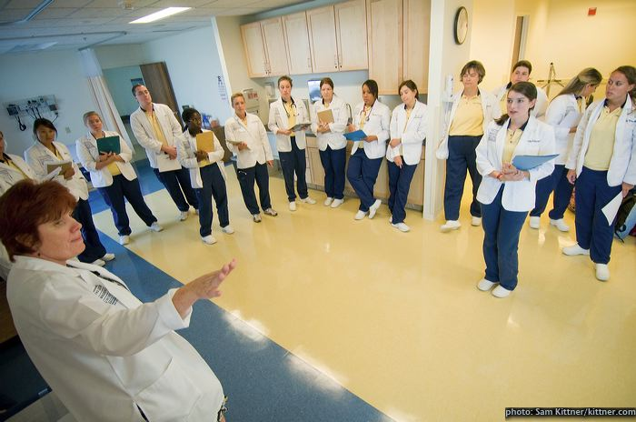
IOM – Education Recommendations
Increase the proportion of nurses
with BSN and higher degrees
Increase the number of nurses
with doctorates
Implement nurse residency programs
Promote lifelong learning

Slide 22

National Employment Trends
39% of hospitals/other healthcare settings prefer hiring new RNs with BSN (AACN, 2012)
77% of employers have strong preference for BSN educated nurses
Strong data supporting better outcomes with employment of higher proportion of BSN prepared nurses
Move to Magnet
  Require all nurse managers/leaders to hold > BSN by 2013
  Have plan in place for achieving 80% BSN by 2020
Salaries more than 10% higher (HRSA)
Notes:
AACN 2012, Employment of New Nurse Graduates & Employer Preferences for Baccalaureate-Prepared Nurses
Data going back to the 1990s showing better outcomes, lower mortality rates, and less errors by BSN prepared nurses.
October 2012 Medical Care – Univ. of Pennsylvania found that surgical pts. In Magnet hospitals had 14% lower odds of inpatient death within 30 days and 12% lower odds of failure-to-rescue compared to patients in non-Magnet hospitals. May 2008 – report by Dr. Linda Aikens & colleagues confirmed findings from 2003 study showing for every 10% increase in proportion of BSNs was associated with a 4% decrease in the risk of death
Studies have also demonstrated in ADN/diploma grads who complete BSN – higher competency in practice, communication, leadership, critical thinking, professional integration, and research/evaluation.
Employers validate skills BSN brings to workforce with higher compensation

Slide 23

Texas Challenge-Undereducated Workforce
Texas Challenges to achieving 80% BSN and doubling number with doctorates:
252,727 RNs in 2013
51% have BSN or higher
49% have ADN or Diploma
61% of Texas SONs are ADN programs
Only 16% of ADNs/Diploma continue on to earn higher degree
Data from Texas Center for Nursing Workforce Studies
and Texas Board of Nursing, 2013
Notes:
In a 2010 survey done by the TNA Education Committee to gather perceptions of AND students about plans to enroll in a BSN program responses revealed 4 barriers:
Lack of time
Family obligations
Lack of financial aid
Number of prerequisite courses needed

Slide 24
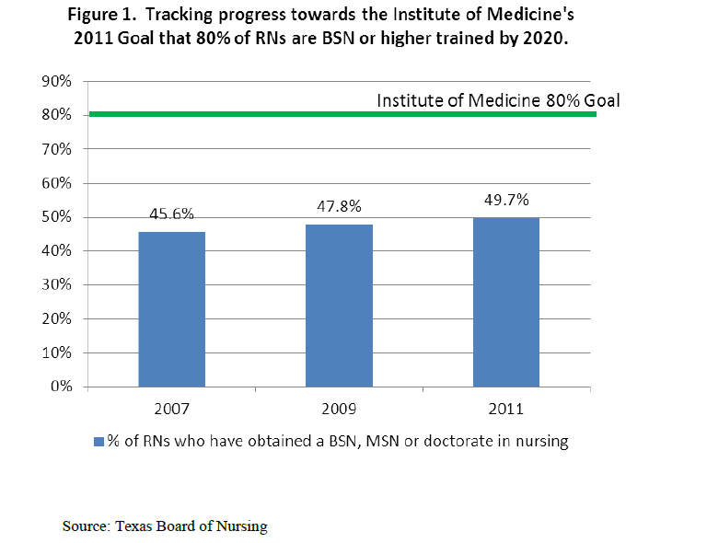
Texas Progress toward IOM Goal
Notes:
http://www.dshs.state.tx.us/chs/cnws/Nursing-Workforce-Reports/

Slide 25
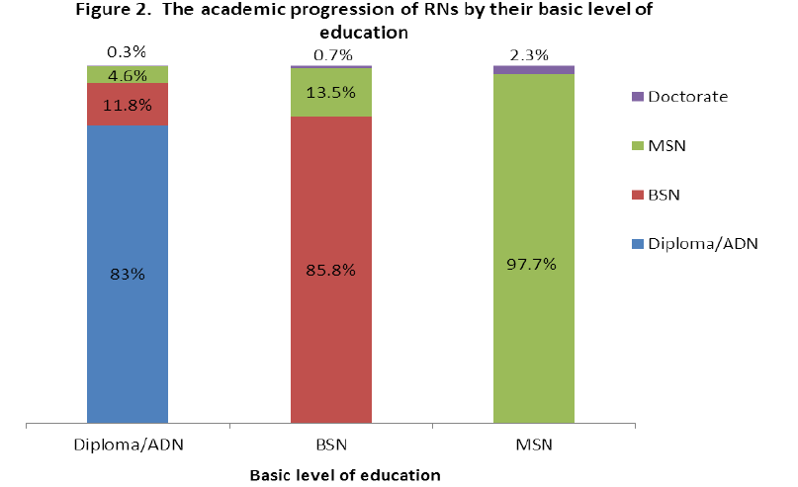
Nursing Workforce Data
Notes:
http://www.dshs.state.tx.us/chs/cnws/Nursing-Workforce-Reports/

Slide 26

Texas Challenge-Undereducated Workforce
Gulf Coast Region
  54,903 registered nurses
    BSN or higher = 30,671 (56%)
  Highest degree
    BSN - 46.6%
    MSN – 8.68%
    Doctorate (Nursing) - 0.6%
Data from Texas Board of Nursing, 2012

Slide 27
Gulf Coast Challenge-Undereducated Workforce
County | % BSN or higher
Austin | 40.7%
Brazoria | 57.3%
Chambers | 37.9%
Colorado | 36.9%
Fort Bend | 60.8%
Galveston | 47.6%
Harris | 57.8%
Liberty | 29.0%
Matagorda | 28.7%
Montgomery | 47.5%
Walker | 43.5%
Waller | 44.2%
Wharton | 55.2%
Data: Texas
Board of
Nursing,
2012

Slide 28
Increasing the Percentage in Texas
2005 TCNWS Supply/Demand Study projected need for 293,000 Texas RNs in 2020
2020 goal = 234,400 RNs prepared at BSN or higher by 2020
Texas had 95,645 BSN+ in 2011 – 6809 > 60 years old
Producing 1800 RN-BSN graduates per year
Need to continue pre-licensure ADN and BSN programs
Need to produce 17,000 BSNs per year to meet projected need in 2020

Slide 29
RNs by Age in Texas, 2013
Texas Board of Nursing, 2013
Notes:
Majority of RNs currently ages 40 and above. There are a disproportionate number of nurses nearing retirement. In the U.S., the average age of RNs is 45.5. In Texas, 53% of nurses are 45 or older (30% are 55 or older- almost a third of our nurses).
Need to attract more into nursing at a younger age and move to a higher education level earlier in career.

Slide 30

Increasing the Number of BSN Prepared Nurses
Enrollment in RN to BSN programs have increased every year for the past 10 years – 22.2% in 2011-2012 (AACN 2004, AACN 2012)
288% increase in enrollment since 2003
646 programs available (> 400 offered at least partially online) – 41 accredited BSN programs in Texas
Notes:
Increasing number of nurses recognizing need to advance their education and many employers providing funding and support to facilitate academic progression.
Enrollment in RN-BSN programs grown from 31,215 in 2003 to 89,975 in 2011. Number of programs have grown as well
In 2012 the Joint Statement on Academic Progression for Nursing Students and Graduates was endorsed by AACN, American Association of Community Colleges, Association of Community Colleges Trustees, NLN, & National Association for Associate Degree Nursing – first time leaders representing CC presidents, boards & administrators have joined with nsg ed. Organizations to promote academic progression in nsg (support pursuit of higher education with goal of well-educated, diverse nsg workforce

Slide 31
51%
80%
Meeting goal for Texas will require educational mobility, collaboration, funding, and innovative models

Slide 32
Texas Challenge-Undereducated Workforce
In 2013, there were 1153 doctorally (nursing) prepared nurses residing in Texas (in 2009 – 625)
Texas exceeds US average per population for LVNs
  76,869 employed in nursing in state
  US ratio 237 per capita
  Texas ratio 281 per capita
  Data: Texas Board of Nursing, 2013, 2011; HRSA, 2010)

Slide 33
Texas Team Advancing Education
Improving Nursing Education
Increase proportion of nurses with a BSN degree to 80% by 2020
Identify barriers and challenges
Double the number of nurses with a doctorate by 2020
Availability of nurses educated at the doctoral level impacts nursing education and practice
Explore nursing educational opportunities for nurses seeking advanced degrees in nursing education
Make recommendations to improve access and increase number of BSNs
Identify programs with effective outcomes

Slide 34
Issues Impacting Nursing Education
Faculty Shortages
Clinical Placements
Difficulties Transferring Between School of Nursing

Slide 35


Academic Progression in Nursing (APIN)
RWJF two-year grant for $300,000
PIs – Dr. Helen Reid and Dr. Kathryn Tart
Focus on building highly educated, diverse nursing workforce; building the pipeline
Consortium for Advancing Baccalaureate Nursing Education in Texas (CABNET)
Goal – 130% increase in RN-BSN graduates by 2013-2014
Notes:
Continuing work of the Perkins Leadership Grant which was a consortium of 8 ADN and 4 BSN programs to create a competency-based 1+2+1 seamless curriculum for RN-BSN. CABNET is intended to promote the adoption. (increase from 1,826 RN-BSN grads in 2010-11 to 4,200 by 2013-14)
Texas 1 of 9 states receiving the 2 year grant (AONE running the Phase 1 – 2 year initiative; RWJF will support additional 2 years if benchmarks met or exceeded
Led by Dr. Helen Reid (provost, Health Science Center, Trinity Valley Community College & Dr. Kathryn Tart (dean UH-Victoria); co-project leader Dr. Susan Sportsman (co-chair of TT Action Coalition Executive Committee and co-leader of its Advancing Nursing Education Team
TNF/TNA administering the grant.

Slide 36
Academic Progression in Nursing (APIN)
Statewide model of general, standardized general education/prerequisites (1+2+1)
Concept-based curriculum
Goal of 40 community colleges and 20 universities
Coach and mentors for students in need
Practice partners needed (contact Dr. Reid at hreid@tvcc.edu)
Notes:
Concept curriculum chosen to manage content saturation and provide a method for content management
Participating community colleges and universities will partner with a clinical site to assess competencies of “the nurse of the future” as they relate to leadership, cultural competencies/diversity, interprofessional collaboration, and quality and safety.
Currently have 16 CC and 9 universities involved
Practice partners needed – contact Helen Reid

Slide 37

IOM – Practice Recommendations
All practitioners should practice to the
full extent of their education and training
Physicians, nurses and other health professionals work in a team-based model of care delivery
Models of care maximize time that providers can spend on their respective roles and responsibilities to patients
Notes:
This Campaign also seeks to enable all nurses to practice to the full extent of their education and training. Primary care in the United States is struggling to meet patients’ needs, and staffing shortages will only be exacerbated over the next decade as millions of newly insured Americans seek care and the population continues to age.
For both immediate and long-term needs, solutions must enable nurses, as well as other health professionals, to practice to the full level of their education and training in a team-based model of care delivery.
Moreover, they should create models of care that maximize the time providers can spend on their respective roles and responsibilities to patients.

Slide 38
Nurses should practice to the full extent of their education and training
17 states and D.C. allow nurse practitioners (NPs) full practice authority. 21 states have reduced practice and 12 states have restricted practice.
No data indicate poorer patient outcomes, nor is there an increase in malpractice claims
Ample evidence that NPs diagnose and prescribe safely without such oversight

Slide 39
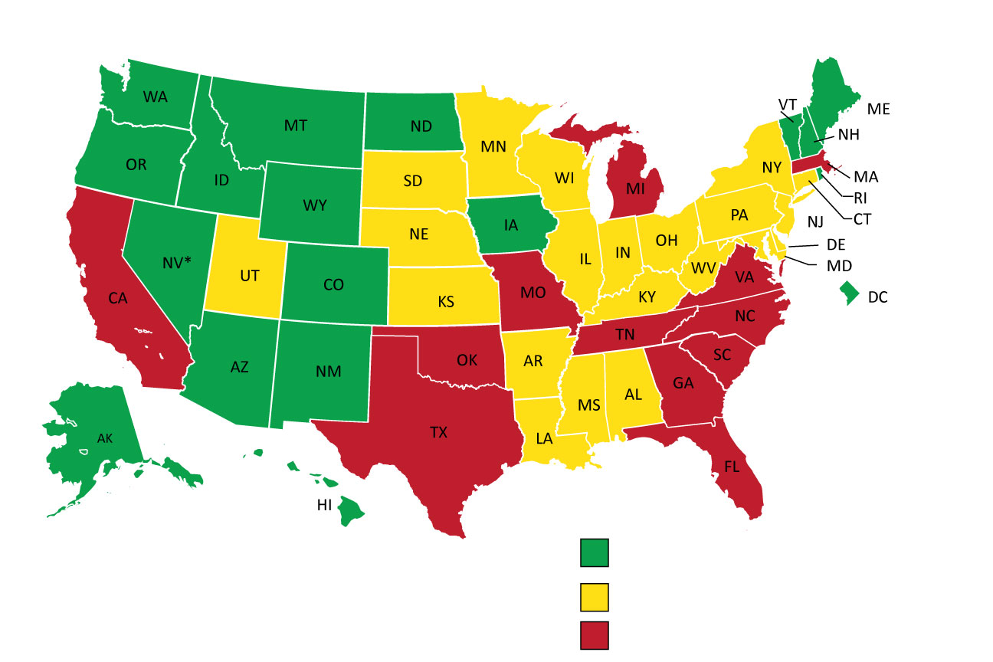
Practice and Care: A Patchwork of Laws
Legal Environment for APRN¹ Practice and Care
Full Practice
Reduced Practice
Restricted Practice
¹ This map from AANP shows the practice environment for nurse practitioners. For more detail about other types of APRNs, see NCSBN’s maps: https://www.ncsbn.org/2567.htm.
Notes:
This map from the American Association of Nurse Practitioners (AANP) shows the practice environment for nurse practitioners. As you can see, nurse practitioners in 12 states have restricted practice and in 21 states have reduced practice. Only in 17 states and the District of Columbia do nurse practitioners have full practice authority.
In Utah, nurse practitioners have full practice authority, except for prescribing controlled substances. This means that California is the only state west of the Continental Divide that hasn’t modernized their scope of practice laws. For more information about practice restrictions for other types of APRNs, visit the National Council of State Boards of Nursing’s (NCSBN) website.

Slide 40

Nurses should practice to the full extent of their education and training
Texas needs the right mix of healthcare providers, functioning to the full extent of their education and certification
Need to remove legislative barriers to allow Advanced Practice RNs (APRNs) to practice as they are nationally educated and certified

Slide 41
Texas Team Efforts to Enable Nurses to Practice to Full Scope – Perryman Report
“The Economic Benefits of More Fully Utilizing Advanced Practice Registered Nurses in the Provision of Health Care in Texas: An Analysis of Local and Statewide Effects on Business Activity”
Commissioned by Texas Team
Conducted by Dr. Ray Perryman – nationally and internationally recognized economist
$8 Billion in annual economic output generated from better utilization of APRNs by State
Press conference in Austin on May 14, 2012
(view at www.facebook.com/TxTeamNursing )
Full Report at: www.texasnurses.org
Notes:
Perryman found that at current levels of activity, the impact of efficiency gains from greater use of APRNs (including multiplier effects) would be 97,205 new permanent jobs, $8 billion in annual economic output (gross product) and $16.1 billion in total expenditures per year within Texas. The economic stimulus would spark additional yearly tax receipts of $483.9 million to the State of Texas and $233.2 million to local governments.
Over time, economic benefits would grow, according to the report, which includes projections for 2020, 2030 and 2040. By 2040, the total impact would reach 177,220 permanent jobs with $23.6 billion in economic output and almost $46.9 billion in total expenditures each year. The State of Texas would see its annual tax receipts boosted by $1.432 billion, with another $538.1 million going to local government coffers.

Slide 42
Supply by Surrounding County of Practice
County | # PCP MDs | # NPs
Austin (179) | 9 | 5
Brazoria (135) | 145 | 43
Chambers (209) | 7 | 2
Colorado (47) | 16 | 2
Fort Bend (82) | 348 | 92
Galveston (91) | 166 | 106
Harris (38) | 3306 | 1224
Liberty (149) | 33 | 8
Matagorda (65) | 25 | 3
Montgomery (53) | 346 | 103
Waller (224) | 3 | 2
Walker (63) | 43 | 8
Wharton (74) | 27 | 7
29 counties have no PCP MDs; 20 counties have 1; 15 counties have 2 (includes FP, GP, IM, Peds, OB/Gyn, Geriatrics)
Texas Dept. of State Health Services, 09/2011

Slide 43
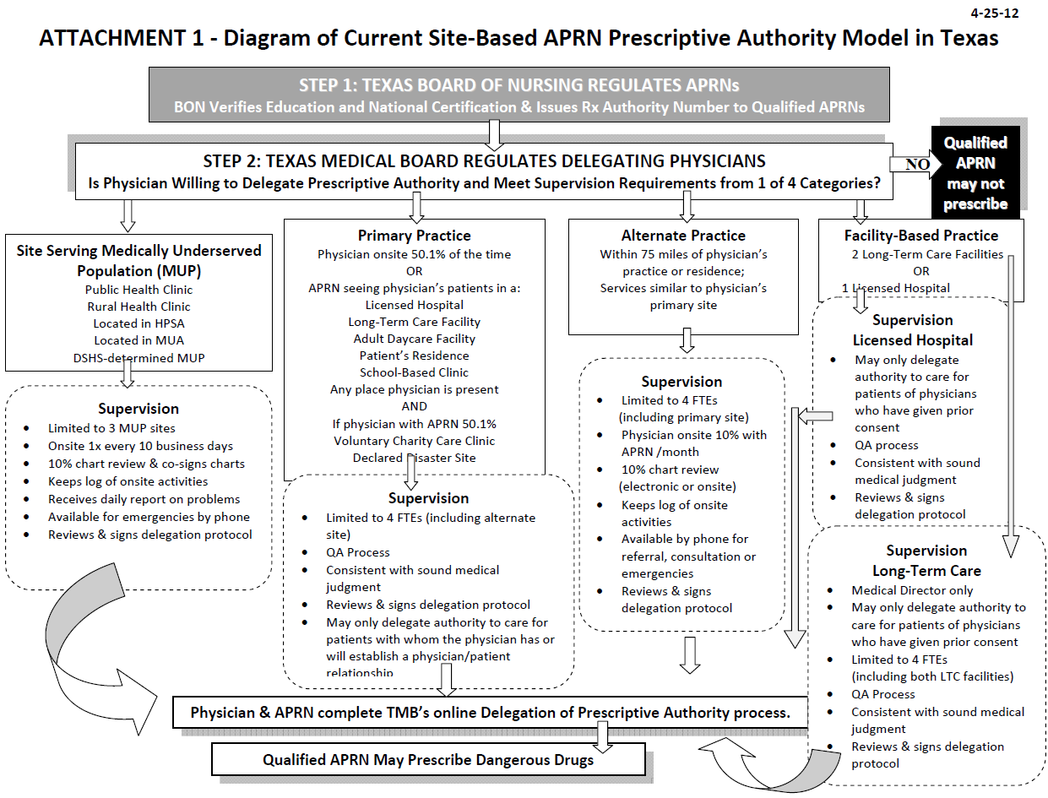

Slide 44
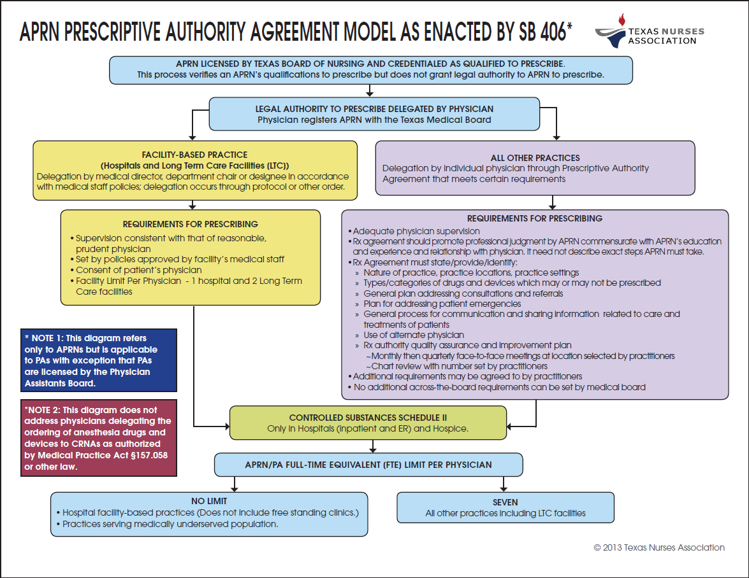

Slide 45
83rd Texas Legislature
SB 406 filed by Senator Jane Nelson (R) [Chair – Senate Health & Human Services Committee] – passed and signed by Governor Perry; in effect 11/01/13
Supported by TMA and TAFP
FTEs – increased to 7; unlimited for MUPs or hospitals
Frequency of meetings – face-to-face monthly for 3 years and then quarterly (with monthly in-between remotely); 1 year if in practice at least 5 years
Location of meetings – jointly decided and indicated in prescriptive authority agreement
QA & QI plan – jointly decided including number of charts to be reviewed
Controlled substances – delegation of Schedule II to APRNs in hospitals and for hospice care
Prescriptive authority agreement – will identify types/categories of drugs/devices that can or cannot be prescribed (maintains current law)
Agreement reviewed, signed, and dated annually

Slide 46
83rd Texas Legislature
SB 406 is an agreed-to-bill, between nursing & medicine that increases access to care and maintains patient safety by: Replacing current site-based requirements with a standardized prescriptive authority agreement that requires practitioners (physicians, APRNs and/or PAs) to develop & sign an agreement that is best for their practice as a professional team. Establishing minimum standards for prescriptive authority agreements but gives practitioners flexibility to determine specifics of the agreement. Allowing hospital-based practices & practices serving MUPs to remain unlimited in number of APRNs/PAs that physicians may delegate prescriptive authority. Increasing from 4 to 7 the number of individuals to whom physician may delegate prescriptive authority at all other practice sites. Improving coordination between the TMB, TBON, & TPAB.

Slide 47
83rd Texas Legislature
SB 406 is an agreed-to-bill, between nursing & medicine that increases access to care and maintains patient safety by (cont.): Ensuring that APRNs & PAs are treated the same as physicians in Medicaid & CHIP for the purposes of being assigned as PCPs. Clarifying that a physician in a hospital may only delegate prescribing of Schedule II Controlled Substances to APRNs & PAs for patients in hospice settings, the ER, & patients admitted to the hospital for an intended length of stay for at least 24-hours. Clarifying that prescribing of DME is reimbursable under Medicaid when prescribed by an APRN & PA, to extent allowed by federal law. Clarifying that the limitation on the TMB’s rulemaking authority on prescriptive authority agreements does not limit the Board’s ability to adopt rules relating to a physician’s general authority to delegate.

Slide 48

IOM – Leadership Recommendations
Nurses bring important viewpoint
to management and policy discussions
Notes:
Nurses bring an important voice and point of view to management and policy discussions. We need to prepare more nurses to help lead improvements in health care quality, safety, access and value.

Slide 49





Changing Image and Roles of the Nurse

Slide 50

Transforming Nursing Leadership
Nurses must build leadership skills
Nurses need better understanding of systems leadership and quality sciences
Identification of the unique contributions nurses make to health care committees or boards
Identification of the skills and knowledge critical to leaders of/in healthcare organizations (ACOs, healthcare homes, clinics, acute care)

Slide 51
Preparing and Enabling Nurses to
Lead Change in Texas
Nursing leadership – need younger and more diverse nurses to join us
Need others to join the Campaign – business, policy leaders, other health professionals, philanthropy
Ensure nurses are engage in health care reform decisions in Texas
Need more nurses in legislature and on boards

Slide 52
Leadership at Every Level
Evidence: Transforming Care at the Bedside (TCAB)
  Nurses create, test, and implement changes to improve patient care
Results
  Falls with harm, “Code Blue” calls, 30-day re-admissions declines
  71% of unit nurses felt their ideas counted after TCAB; up 13%
Notes:
With much care being delivered in med-surg, & with an estimated 35-40% of unexpected hospital deaths occurring on such units, RWJF & IHI worked together to create, test, & implement changes that will dramatically improve care on these units, & improve staff satisfaction as well.
In 2003, through an initiative called Transforming Care at the Bedside (TCAB), RWJF & IHI created a framework for change on med-surg units built around improvements in 4 main categories:
Safe and Reliable Care; Vitality and Teamwork; Patient-Centered Care; Value-Added Care Processes
Over several years, participating hospitals tested, refined, & implemented change ideas within each of the 4 categories, many with very promising early results. Examples include the following:
Use of Rapid Response Teams to “rescue” patients before a crisis occurs
Specific communication models that support consistent & clear communication among caregivers
Professional support programs such as preceptorships & educational opportunities
Liberalized diet plans & meal schedules for patients
Redesigned workspace that enhances efficiency & reduces waste
Many changes cannot be strictly categorized, but produce positive change in 1 or more categories. Only by working in all 4 categories simultaneously that care teams can produce truly transforming results.
​(Seton Healthcare and MDACC are participants in project)

Slide 53
Preparing and Enabling Nurses to
Lead Change in Texas
Nursing leadership – need younger and more diverse nurses to join us
Need others to join the Campaign – business, policy leaders, other health professionals, philanthropy
Ensure nurses are engage in health care reform decisions in Texas
Need more nurses in legislature and on boards

Slide 54



What You Can Do
Incorporate recommendations into your strategic plans
Mentor new nurses
Promote leadership
Encourage lifelong learning
Make sure nurses are on committees
Keep good data on all nurse-led innovations
Notes:
You can incorporate the recommendations into your organization’s strategic plans.
Second, you can promote nursing leadership. If there’s a new piece of technology being considered at your facility or a new quality improvement program that will be tested, make sure that nurses are involved in the decision-making process. Ensure that a nurse sits on the committee overseeing it.
Make sure you mentor new nurses and get them to be leaders. Encourage lifelong learning.
Keep exceptional data on nurses’ contributions so that you can prove to management that the contributions you are observing are in fact improving quality and promoting efficiency.

Slide 55
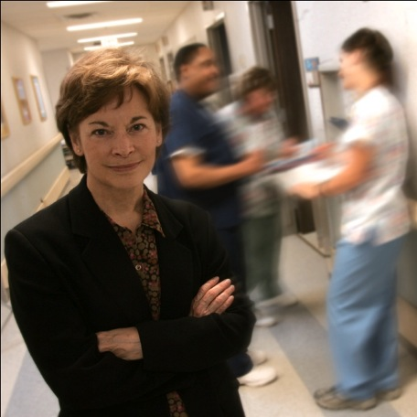
What You Can Do
Translate IOM report for your staff; share main findings with executives
Require new hires to have BSN or to get one within five years
Develop plans for how you can assist your staff to achieve academic progression
Notes:
Make sure that you know everything in the IOM report and translate it for your staff. And share the main findings from the report with your leaders and directors.
Encourage your organization to adopt a formal policy requiring new hires to have a BSN degree, or to require nurses with an AD degree to return to school within five years.
Develop plans for how you an assist your staff to achieve academic progression.
These are just a few ideas… and I’m sure you will have more ideas as well about how you and your organization/institution can get involved in advancing the IOM recommendations. We need your support to transform nursing and improve patient care. So join the Texas Action Coalition. Together, let’s transform our field and improve patient care.

Slide 56

Grassroots Ways to Respond
Respond to articles from newspapers or magazines
Write articles or opinions
Contact local newspapers, magazines, media
Attend networking opportunities (professional and public)
Contribute your time and visit your legislators to discuss issues
Seek involvement opportunities inside
and outside of nursing
Contribute financially
GET INVOLVED

Slide 57
Implementation: Your Role
1) Connect with Texas Team and your Regional Leadership Team
2) Explore more about ACA and educate your organization, and read the IOM Report and integrate ideas/methodologies
3) Your organization can join the Texas Team – contact alexia.green@ttuhsc.edu for application

Slide 58
IFN - Campaign Resources
Visit us on the Web
http://www.dshs.state.tx.us/chs/cnws/texasteam/
http://www.texasnurses.org/displaycommon.cfm?an=1&subarticlenbr=582
Join us on Facebook
http://www.facebook.com/TxTeamNursing

Slide 59
Gulf Coast
Regional Leadership Team
For information on team activities in the region, to join the Coalition, or to find a speaker for your organization/institution contact:
  Dr. Susan D. Ruppert
  Susan.D.Ruppert@uth.tmc.edu

Slide 60


Invest in the Journey
Notes:
A ship is in harbor is safe but that is not what a ship is built for.
In harbor no movement, one of many, does not stand out, not fulfilling its utility
At sea, may encounter turbulence or may have times of peace and calm. Both are part of the adventure and all experience lead the journey to the final destination.
Take the journey, enjoy the experiences, steer the course its final destination. If we don’t take the trip, we will be left behind.

Slide 61


